Slide 1
Optimization, simulation and integration
Maja Pušnik
University of Maribor
Faculty for electrical engineering and computer science

Slide 2

ELECTRICAL ENGINEERING
COMPUTER SCIENCE AND INFORMATION TECHNOLOGIES
INFORMATICS AND TECHNOLOGIES OF COMMUNICATION
TELECOMMUNICATIONS
MEDIA COMMUNICATIONS

Slide 3
INFORMATICS AND TECHNOLOGIES OF COMMUNICATION (bachelor degree)
  INFORMATICS AND TECHNOLOGIES OF COMMUNICATION
  (1. year)
  INFORMATION SYSTEMS (2-3. year)
  TECHNOLOGIES OF COMMUNICATION (2-3. year)
INFORMATICS AND TECHNOLOGIES OF COMMUNICATION (masters degree) 2 years

Slide 4

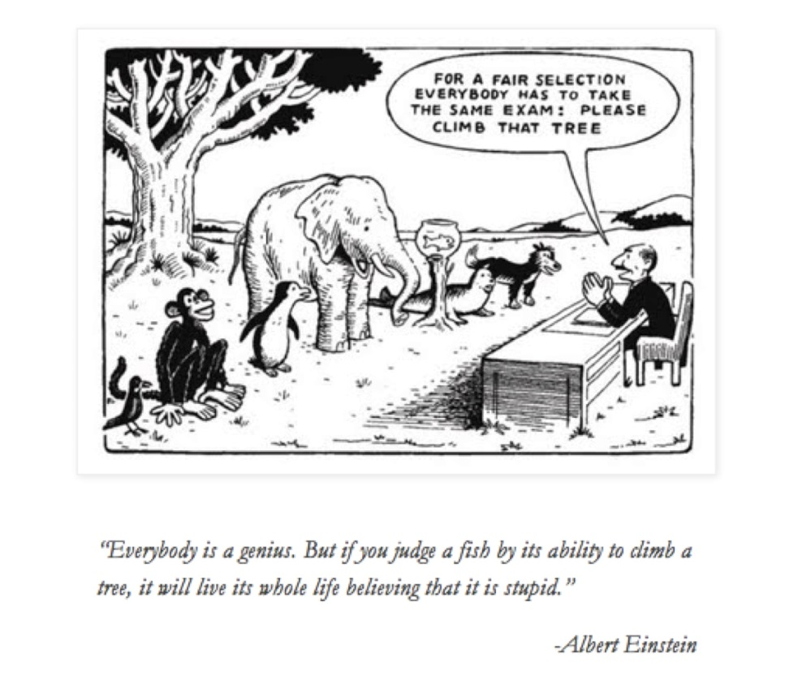
What we provide?
Learning all steps of IT systems life cycle
What is sometimes missing?
Informatics can not evolve without the involvement of other disciplines

Slide 5
Focusing on the needs of today‘s problems
HIGH PROFIT
HIGH QUALITY
BALANCE
LOW COST
LOW EFFORT
Hardware, low computer literacy, old habits are no longer the problem;
the problem is closely connected to economy, time shortage, needs for flexibility…

Slide 6
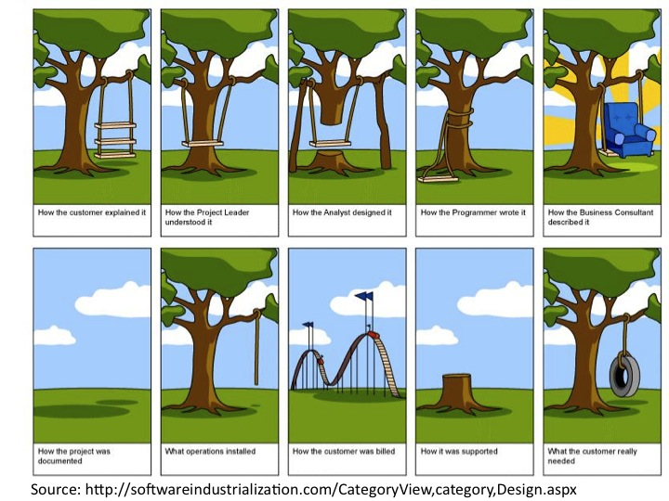
Nurturing communication skills
We have little rhetorical classes/subjects
We compensate the need to communicate, stand up in front of a crowd and cooperate inside groups through projects and presentations.

Slide 7
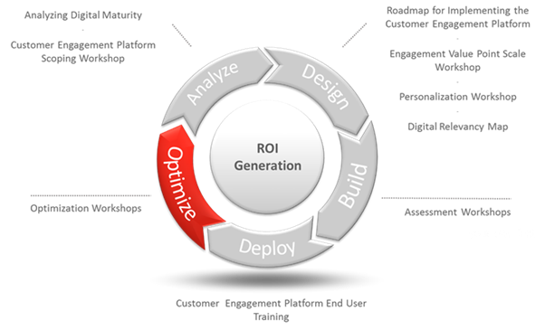
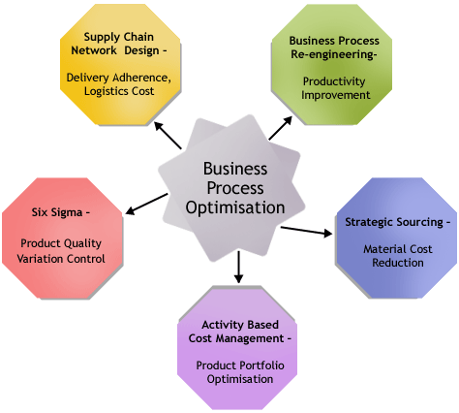
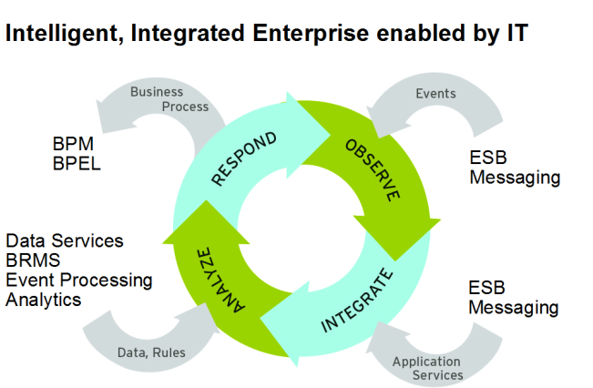
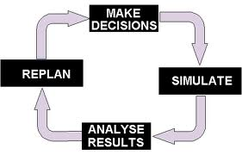
Re-thinking each step in development process

Slide 8


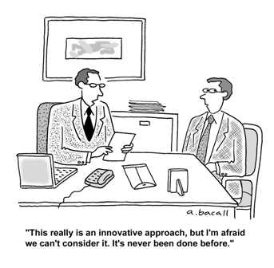
The need for interdisciplinary way of thinking
Developer
User/Custumer
Problems
  Poor knowledge about economic priorities
  Narrow overview about law issues
  No negotiation skills
  No social skills development
  Although working in groups, often no leadership volunteers

Slide 9
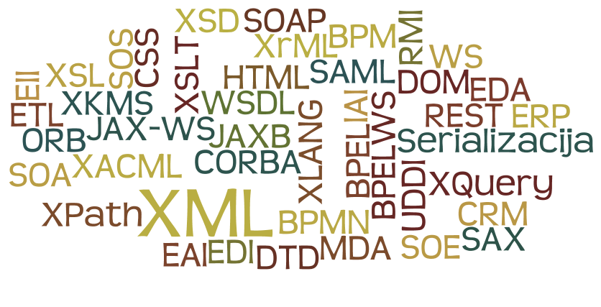
Graduate knowledge building
Step: learning the code
Step: learning to re-code
Step: learning to use existing knowledge/services
Step: learning to plan/optimize the process behind the code
Step: learning to reshape the process to ones advantage

Slide 10
Addressing subjects
Information systems platforms (1)
Decision making models and systems (2)
System convergence and integration (3)
Optimization of business processes (4)
Simulation and operational research (4)

Slide 11


How to do well from the start?
Information systems platforms
Decision making models and systems
System convergence and integration
Optimization of business processes
Simulation and operational research

Slide 12
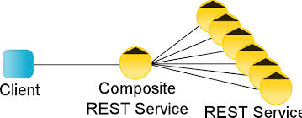

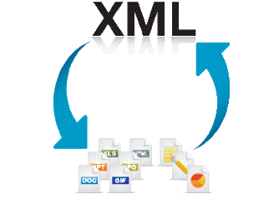
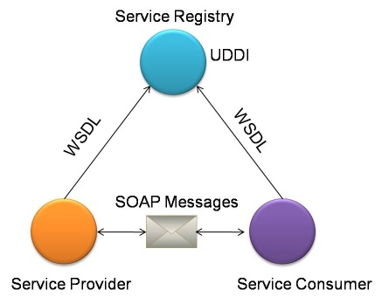
How to use what already exists?
Information systems platforms
Decision making models and systems
System convergence and integration
Optimization of business processes
Simulation and operational research
Notes:
How to do it well from the start
How to use what already exists
How to improve it
How to spend little
How to earn much

Slide 13



Integration example
Constant change demand a company to integrate business
processes with business partners (24/7)
Buyer: supplier
Order
Internet
Supplier
Invoice
Buyer

Slide 14
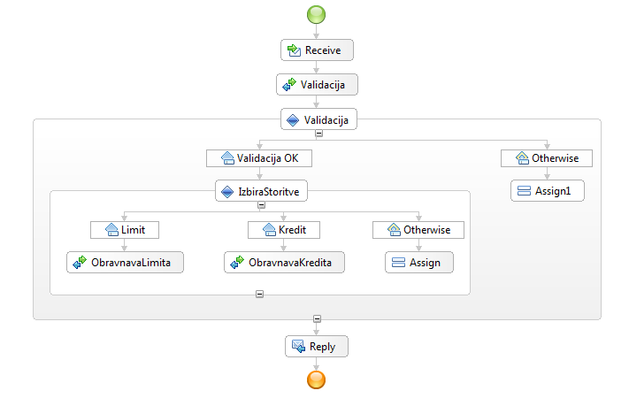
Orchestration and choreography of web services
Web services (SOAP or REST) are not enough (they hold only technical information needed for using them)
Using BPEL to make a business process out of separate and dispersed web services
Building BPEL in IBM Web sphere designer
XML in the background
Notes:
Spletne storitve je potrebno na nek način sestavljati, upravljati, nadzorovati… Potrebno je določiti, kateri poslovni procesi oziroma operacije spletnih storitev bodo med seboj sodelovale, kakšno bo zaporedje in podobno. In na tem mestu prideta v poštev orkestracija in koreografija spletnih storitev v poslovne procese. Glavna razlika med njima je v tem, da je koreografija bolj sodelovalnega tipa in omogoča vključevanje vsem udeležencem poslovnih procesov in je povezana z javno izmenjavo sporočil, ki se izmenjajo med več spletnimi storitvami. Orkestracija pa vključuje poslovno logiko, upravljanje transakcij in na nek način odreja korake v procesu.
Orkestracija se nanaša na izvršilne poslovne procese, ki lahko sodelujejo z internimi in eksternimi spletnimi storitvami na nivoju sporočanja. Vključena je poslovna logika in vrstni red izvrševanja opravil. Orkestracija vključuje upravljanje transakcij med individualnimi storitvami, vključno s potrebnim obravnavanjem napak, kot tudi opisovanjem splošnega procesa. Tako lahko orkestracijo smatramo kot konstrukt med avtomatiziranim procesom in individualnimi storitvami, ki odrejajo korake v procesu. Orkestracija zmeraj pomeni kontrolo iz perspektive enega udeleženca.
Koreografija vključuje predvsem sodelovanje in omogoča vključevanje vseh udeležencev. Koreografija sledi vrstnemu redu sporočil eksternih spletnih storitev [3], ki vključujejo večkratne dele in več virov, vključno s strankami, dobavitelji in partnerji. Koreografija je tipično povezana z javno izmenjavo sporočil, ki se izmenjajo med več spletnimi storitvami, in ne v specifičnem poslovnem procesu, ki se izvrši le na eni strani.

Slide 15
Role of XML related technologies
Aplication1
XML
XSD
DTD
Transformation
XSLT, Xpath, XQuery
XML
Inquiery
Application2
XML
XSD
DTD
Transformation
XSL-FO
Notes:
XML je integracijska tehnologija
Omogoča izmenjavo elektronskih dokumentov
Znotraj podjetja
Med podjetji
XML podpirajo praktično vse platforme
XML omogoča definicijo lastnih besednjakov
Poenotenje pri besednjakih za osnovne poslovne dokumente
e-Slog

Slide 16


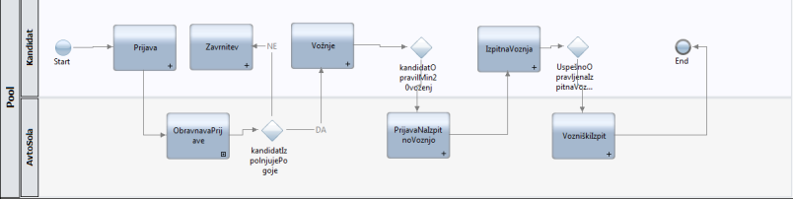

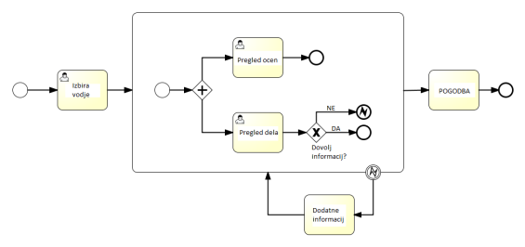

How to improve the old?
Information systems platforms
Decision making models and systems
System convergence and integration
Optimization of business processes
Simulation and operational research
BPMN NOTATION
Notes:
How to do it well from the start
How to use what already exists
How to improve it
How to spend little
How to earn much

Slide 17
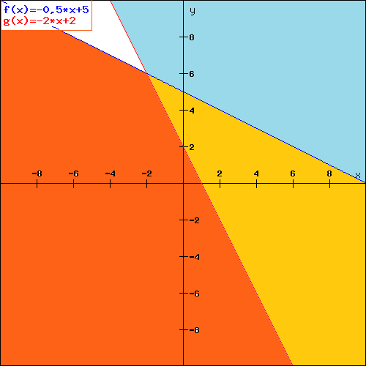
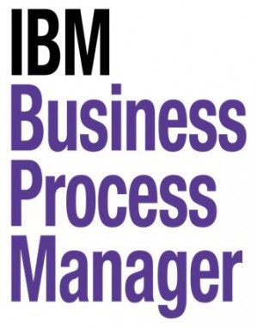
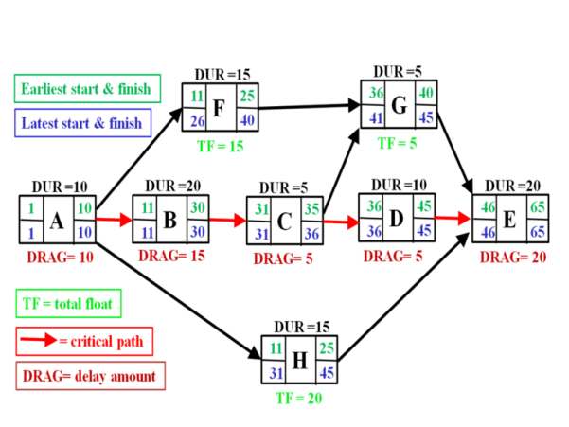
How to make everyone happy?
Information systems platforms
Decision making models and systems
System convergence and integration
Optimization of business processes
Simulation and operational research
Notes:
How to do it well from the start
How to use what already exists
How to improve it
How to spend little
How to earn much

Slide 18
Focusing on cost-effort-effectiveness
X2
Critical path method
Cost analysis
Sensitivity analysis
Graphical methods (learning to use
the mathematical knowledge of linear algebra)
Learning basic mathematical models in finding solution (linear and nonlinear programming, gradient methods)
A
D
Dummy
X1
X3
X5
B
E
X4
C
F

Slide 19
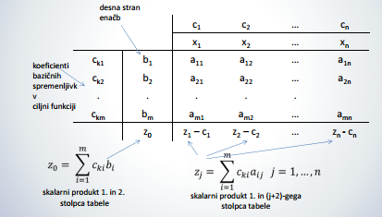
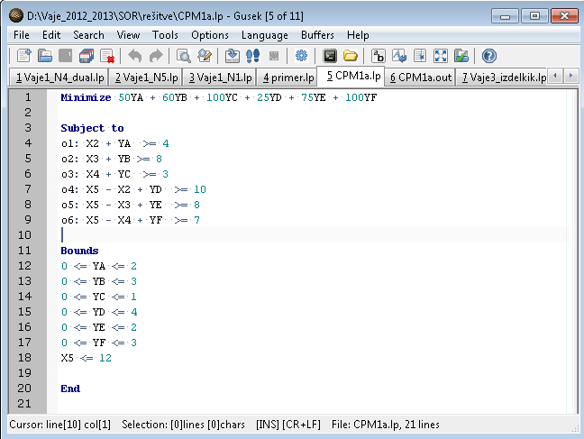
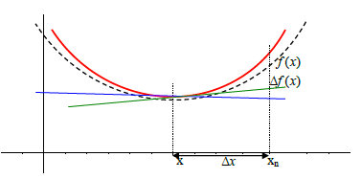
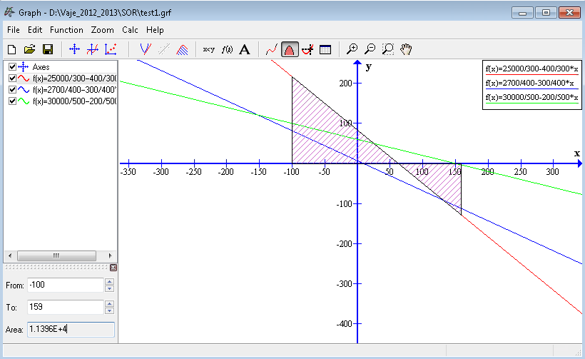
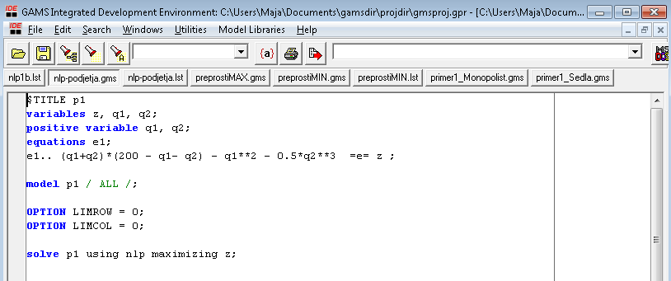

Slide 20
Learning focus across the years
Information systems platforms (1st year)
Decision making models and systems (2st year)
System convergence and integration (3st year)
Optimization of business processes (4st year)
Simulation and operational research (4st year)
Results
Students approach more holistically to their problems (they think beyond the code)
Finally seeing (at least partially) the point in learning linear algebra
Notes:
How to do it well from the start
How to use what already exists
How to improve it
How to spend little
How to earn much

Slide 22
Problems
Too complex tools (hard to obtain by students, demanding ‚faster‘ computers, which we cannot provide in school in sufficient manner)
Not enough free software on the market
The subject are not all obligatory, students do not receive the whole overview
Demanding a more personal approach (not everything can be checked through our e-learning system, hard to do quick checking through quizzes)

Slide 23
Thank you!
Questions, suggestions?
maja.pusnik@uni-mb.si

